Slide 1

Searching and Sorting Algorithms

Slide 2
What is a searching Algorithm? Searching Algorithms are designed to check for an element or retrieve an element from any data structure where it is sorted or not. Based on the type of search operation, these algorithms are generally classified into two categories:
Sequential Search
In this, the list or array is traversed sequentially and every element is checked.
For example: Linear Search
Interval Search
These algorithms are specifically designed for searching in sorted data-structures. These type of searching algorithms are much more efficient than Linear Search as they repeatedly target the center of the search structure and divide the search space in half. For Example: Binary Search

Slide 3
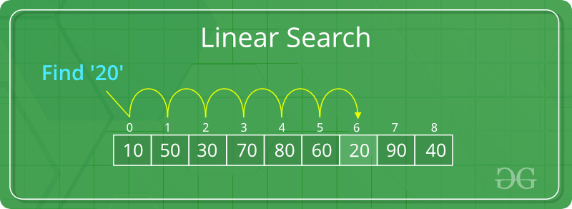
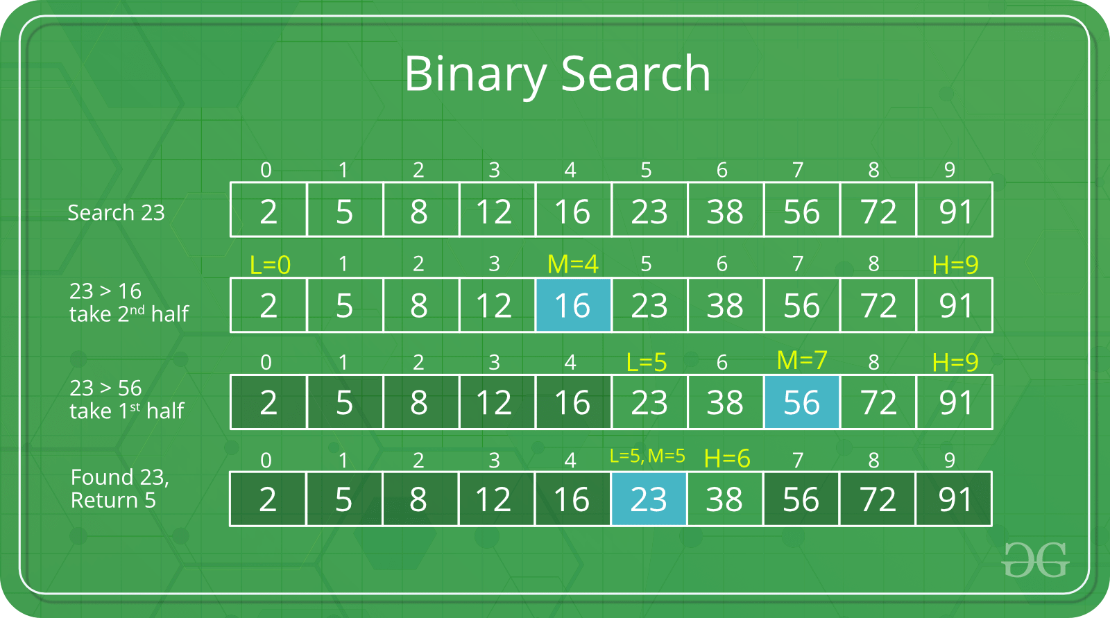
These images are taken from GeeksForGeeks

Slide 4
Pseudocode
LinearSearch(Array , item)
for all index in Array
if element at index is equal to item
return index
end of for loop
return -1
BinarySearch(Array, Item)
let start = 0;
let end = Array size-1
while start <= end
let mid <- (start+end)/2;
if element at index mid is equal to item then return mid
if element at index mid is smaller then item
set start <- (mid+1)
else
set end <- (mid-1)
end of while loop
return -1

Slide 5
Complexity Analysis of Binary Search
Let n is length of array
In 1st Iteration
Length of array is n
In 2nd Iteration
Length of array is n/2
In 3rd Iteration
Length of array is n/4
In k^{th} Iteration
Length of array is n/2^k
Int the K^{th} Iteration the length of array will become 1 so n/2^k = 1
n=2^k taking log(base 2) on both side.
logn=log2^k
logn=klog2
Logn = k since loga(a) =1.

Slide 6

What is a sorting Algorithm? A Sorting Algorithm is used to rearrange a given array or list elements according to a comparison operator on the elements. The comparison operator is used to decide the new order of element in the respective data structure.
For example: The below list of characters is sorted in increasing order of their ASCII values. That is, the character with lesser ASCII value will be placed first than the character with higher ASCII value.

Slide 7
Some of the sorting algorithms-
Bubble sort
Insertion sort
Selection sort
Merge sort
Quick sort
There are a lot of sorting techniques but we will discuss the most popular one which is Merge sort.

Slide 8
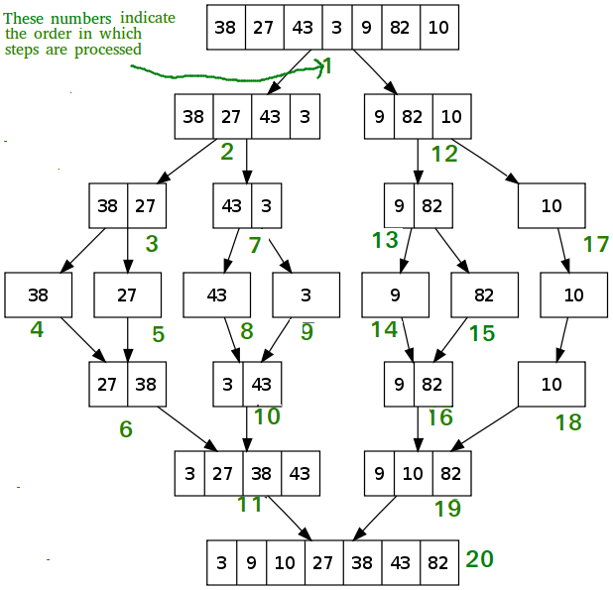
Merge Sort-
Merge Sort is a Divide and Conquer algorithm. It divides input array in two halves, calls itself for the two halves and then merges the two sorted halves. The merge() function is used for merging two halves. The merge(arr1,arr2) is key process that assumes that arr1 and arr2 are sorted and merges the two sorted arrays into one.

Slide 9
Complexity Analysis of Merge Sort
In merge sort we divide array into sub array until we found a subarray which contains only one element. And then we merge them back.
In 1st iteration
T(n) = T(n/2)+T(n/2)+n = 2*T(n/2)+n
In 2nd iteration
T(n/2) = T(n/4)+T(n/4)+n/2 = 2*T(n/4)+n/2
In k^{th} iteration
T(n/2^k) = T(n/2^k+1)+T(n/2^k+1)+n/2^k
From the above recurrence relation
T(n) = (2^k)*T(n/2^k)+k*n
Since we will divide the array until it become single element subarray so n/2^k=1
By solving above k will be log(n) and k*n will become nlog(n).

Slide 10
How to become Good at Programming.
Find your reason.
Start with one Programming language cpp or java (Don’t pick any other language like python of js).
Learn Basics like loop, statement, Arrays , String and Dynamic memory allocation.
Pick any one plateform from Hackerrank, Hackerearch, Leetcode , codechef, codeforces.
Don’t just do programming to get a good job but do programming to improve your problem solving skills.
Some of the most important thing you should learn first-
Recursion
Backtracking
Dynamic Programming
Stack and Queue
LinkedList
Tree (Traversal, binary tree, AVL tree)
Graph (BFS,DFS)

